Slide 1

Integrated Project Plan Group 3: KushKumar Patel (100951716) Maisha Khatoon (100899259) Mansi Daxeshbhai Patel (100948140) Sandhya Mavadhiya (100949690)
Telus Telecommunications

Slide 2
Company background
TELUS, founded in 1990 and headquartered in Vancouver, British Columbia, is one of Canada's leading telecommunications companies.
Over the years, TELUS has expanded its services to become a major player in the telecommunications industry, offering a comprehensive range of services including wireless communication, data, internet, voice, and television services. With millions of customers nationwide, TELUS is recognized for its extensive network coverage and innovative solutions.
Beyond telecommunications, TELUS has diversified into the healthcare sector through its TELUS Health division, which provides digital healthcare solutions such as virtual care, electronic medical records, and pharmacy management. This expansion reflects TELUS's commitment to leveraging technology to improve access to essential services across Canada.
Under the leadership of CEO Darren Entwistle, TELUS continues to focus on customer service, technological innovation, and corporate social responsibility, making it a significant contributor to the Canadian economy and society.

Slide 3
Project Description
TELUS, one of Canada's largest telecommunications companies, is embarking on a project to elevate its customer service experience by leveraging advanced data analytics.
Objective: Develop an Executive Dashboard to provide TELUS’s procurement and logistics teams with real-time, consolidated views of operational metrics, enhancing strategic decision-making and operational efficiency.
Scope: The project involves designing and developing a comprehensive dashboard that integrates data from procurement and logistics, including features like real-time alerts, trend analysis, and predictive analytics to streamline operations and improve performance.
Data Integration: Establish data pipelines for seamless integration of various data sources, ensuring accurate and timely information flow to support decision-making processes.
User Interface: Design a user-friendly dashboard interface that facilitates intuitive interaction and easy access to critical performance indicators such as procurement cycles, inventory levels, and supplier performance.
Expected Outcomes: Enhance strategic oversight by providing actionable insights, improve operational efficiency, and enable better performance monitoring and management within the procurement and logistics departments.
Project Deliverables: The final deliverables will include the fully functional executive dashboard, a detailed user guide, and training materials for staff to ensure effective utilization and ongoing support.

Slide 4
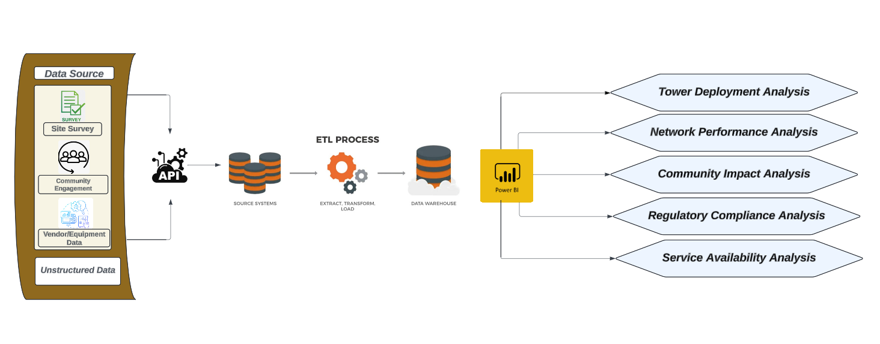
TELUS 5G Network Expansion Solution Architecture

Slide 5
Project Solution
5G Tower Installation: Strategic deployment of new 5G towers in rural and remote areas across Canada, designed to extend TELUS’s network coverage. This will significantly enhance connectivity in underserved regions by delivering faster internet speeds, reduced latency, and improved service reliability.
Infrastructure Upgrades: Upgrading existing telecommunications infrastructure, including 4G LTE towers and backhaul connections, to support the demands of 5G technology. These upgrades will ensure smoother integration of the new 5G network while reducing the deployment time and operational disruptions.
Network Optimization: Leveraging advanced network optimization techniques, such as predictive analytics and machine learning, to fine-tune network performance. This will ensure low latency and high-speed connections while also proactively addressing potential performance issues, ensuring peak network efficiency.
Data Flow and Analytics: Integrating ETL processes to handle the flow of data from various sources like site surveys, community engagement, and network equipment. This data will be normalized, cleaned, and analyzed using Power BI to gain real-time insights into tower deployment efficiency, network performance, regulatory compliance, and community impact, allowing TELUS to make informed decisions quickly.
Community Engagement: Collaborating closely with local governments and community stakeholders to ensure that the 5G tower installations and network expansion align with regional priorities and concerns. This includes addressing environmental, regulatory, and social issues, ensuring that the project moves forward with strong local support and compliance with all necessary regulations.

Slide 6
ProjECT Approach, Size & Complexity
The project follows a phased and iterative approach, utilizing a combination of Agile methodology and traditional project management techniques. The process is divided into five key stages:
Planning
Site Surveys
Infrastructure Deployment
Network Integration
Performance Testing & Feedback

Slide 7
Project scope
In-Scope Items:
Development of data ingestion pipelines
Establishment of data storage solutions
Creation of analytics dashboards
Training for end-users
Out-of-Scope Items:
Legacy system overhaul
Direct customer interface changes
Project Boundaries:
The project will focus on internal data processing and analytics capabilities.

Slide 8
Assumptions & constraints
Important Assumptions:
Technology and resources are available.
Support and involvement of stakeholders.
All available data will be available in formats that are readable.
Principal Restraints:
Budgetary restrictions.
Time restrictions brought on by market forces.
Requirements for compliance and data privacy.

Slide 9
Project planning: Project stakeholders
List of Stakeholders:
Executive sponsors
IT department
Data analytics team
Business units
External vendors
Stakeholder Roles and Responsibilities:
Executive sponsors: Provide strategic direction and approval.
IT department: Manage technical infrastructure.
Data analytics team: Develop and implement data solutions.
Business units: Define requirements and use analytics tools.
External vendors: Supply technology and services.
Communication Plan for Stakeholders:
Regular status meetings
Monthly progress reports
Stakeholder workshops and feedback sessions

Slide 10
Project planning: core project team
Team Structure:
Project manager
Data engineers
Data analysts
IT support
Business analysts
Key Team Members and their Roles:
Project manager: Oversee project execution.
Data engineers: Develop data pipelines and storage solutions.
Data analysts: Create dashboards and reports.
IT support: Maintain infrastructure.
Business analysts: Gather requirements and ensure alignment with business needs.
Team Responsibilities:
Deliver project milestones on time.
Ensure data quality and governance.
Provide regular updates to stakeholders.

Slide 11
Milestone | Timeline
Project Launch | 01/09/2024
Completion of Data Intake Pipeline | 15/09/2024
Implementation of Data Storage Solutions | 01/10/2024
Development of Dashboards and Reporting Tools | 15/10/2024
Instruction and Assistance for Users | 01/11/2024
Project planning: project milestones

Slide 12
Project planning: Work breakdown structure (high level)
Hierarchical Breakdown of Project Tasks:
Define project requirements
Design data architecture
Develop data pipelines
Implement storage solutions
Develop analytics tools
Test and validate solutions
Train users and deploy
Major Work Packages:
Data ingestion
Data storage
Data processing
Analytics and reporting
Deliverables for Each Work Package:
Functional data pipelines
Operational data lake and warehouse
Working dashboards and reports

Slide 13
Project planning: Project risks
Risk Identification:
Data quality issues
Integration challenges
Budget overruns
Delays in timelines
Risk Assessment (Impact and Probability):
High impact, high probability risks
Medium impact, medium probability risks
Low impact, low probability risks
Risk Mitigation Strategies:
Regular data quality checks
Robust integration testing
Contingency budget planning
Close monitoring of project timelines

Slide 14
Project planning: Project budget
Budget Item | Amount
Personnel Expenses | $150,000
Tools and Technology | $75,000
Instruction and Assistance | $30,000
Reserve Money | $20,000
Data Storage Solutions | $50,000
Analytics Tools | $40,000
External Vendor Services | $35,000
Contingency Budget | $20,000

Slide 15

Project planning: Project timeline diagram
Phase | Start Date | End Date
Planning Phase | 01/09/2024 | 10/09/2024
Site Surveys | 11/09/2024 | 20/09/2024
Infrastructure Deployment | 21/09/2024 | 10/10/2024
Network Integration | 11/10/2024 | 20/10/2024
Performance Testing & Feedback | 21/10/2024 | 31/10/2024

Slide 16
Project monitoring: risk management
Regular Risk Assessment Meetings:
To review and discuss potential risks, schedule biweekly risk assessment meetings with key members of the project team and other stakeholders.
To keep track of recognized risks, their possible consequences, and their probability, use a risk register.
Risks should be prioritized according to how they might affect the project's scope, budget, and schedule.
Assign risk owners to oversee and mitigate each risk that has been identified.
Plans for Mitigating Risk:
Provide thorough mitigation plans for risks that are high and medium priority.
Take proactive steps to lessen the chance that risks will materialize or to lessen their effects.
Make sure all mitigation plans are up to date and functioning by periodically updating and reviewing the risk register.
To guarantee preparedness and get the team ready for unforeseen circumstances, conduct risk response exercises.

Slide 17

Change management
Procedures for Handling Change Requests:
Establish a formal change request process that includes submission, review, approval, and implementation stages.
Use a standardized change request form to capture details such as the nature of the change, reasons for the change, and its expected impact.
Implement a change control board (CCB) consisting of project stakeholders and experts to evaluate and approve or reject change requests.
Impact Assessment of Changes:
Conduct a thorough impact analysis for each change request to assess its effect on the project’s scope, timeline, budget, and resources.
Communicate the potential impacts and proposed changes to all relevant stakeholders before making any decisions.
Adjust project plans, schedules, and budgets accordingly to accommodate approved changes while minimizing disruption to ongoing activities.

Slide 18
Meeting Management
Schedule and Agenda for Regular Project Meetings:
Plan and schedule regular project meetings, including weekly team meetings and monthly stakeholder meetings.
Prepare and distribute meeting agendas in advance to ensure all participants are aware of the topics to be discussed.
Assign a facilitator to lead the meetings and ensure they stay on track and within the allotted time.
Documentation and Follow-up Actions:
Record meeting minutes that capture key discussions, decisions, action items, and responsibilities.
Distribute the meeting minutes to all participants and relevant stakeholders promptly.
Track action items and follow up on their completion in subsequent meetings to ensure accountability and progress.

Slide 19
status reporting
Reporting Type | Details
Weekly Status Reports | Provide updates on project progress, accomplishments, issues, and risks.
Monthly Progress Updates | Detailed information on project performance, milestones, financial status, and risk management.
Key Performance Indicators | Include in the reports to measure progress against project goals.
Milestone Achievements | Highlight milestones reached during the reporting period.
Variance Analysis | Analyze any deviations from the project plan and provide explanations.
Areas Requiring Attention | Identify and address any issues that need immediate attention.

Slide 20
escalation, and issue management
Clear Escalation Path for Unresolved Issues:
Define a clear escalation path for issues that cannot be resolved at the project team level.
Establish escalation points, such as project manager, project sponsor, and executive steering committee, depending on the severity and nature of the issue.
Ensure all team members are aware of the escalation procedure and their roles in the process.

Slide 21
Conclusion
Project Goal: Enhance data-driven decision-making and customer experiences at TELUS.
Detailed Planning: Focus on project scope, stakeholder roles, team responsibilities, and risk management.
.
Data Capabilities Improvement:
Integration and processing of data
Generating actionable insights
Benefits:
Better decision-making
Increased customer satisfaction
Enhanced operational efficiency.
Next Steps:
Project setup and data processing initiation.
Regular progress monitoring
Stakeholder engagement
Outcome evaluation and documentation of lessons learned.
Strategic Advancement:
Advances TELUS's data strategy.
Success depends on collaboration among the project team, stakeholders, and partners.
Ensures achievement of TELUS's strategic data goals.

